Slide 1

Introduction to
Embedded and Robotics Programming
Cosmin Bonchis, Alin Brindusescu, Cristi Vladu
Notes:
*** Version of 2017 ***

Slide 2
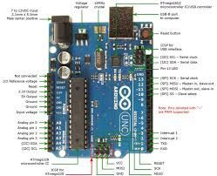
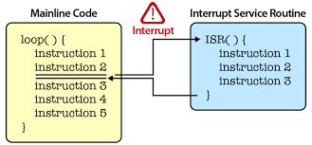
Introduction to Embedded and Robotics Programming
Interrupts
Reset and Interrupt Handling
AVR provides several different interrupt sources
All interrupts are assigned individual enable bits
Global Interrupt Enable bit in Status Register in order to enable the interrupt.
AVR interrupts may be automatically disabled when Boot Lock bits BLB02 or BLB12 are programmed.
  Improves software security
© University of West & Elektrobit (EB) 2018
Notes:
Dielectric, dielectric polarization
Decoupling – filtering the power for unexpected, short interruption

Slide 3
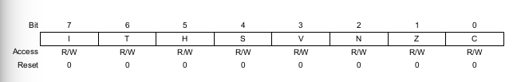
Introduction to Embedded and Robotics Programming
Interrupts – how is working?
When an interrupt occurs, the Global Interrupt Enable I-bit is cleared and all interrupts are disabled.
All enabled interrupts can then interrupt the current interrupt routine.
The I-bit is automatically set when a Return from Interrupt instruction
  RETI – is executed.
Status Register
© University of West & Elektrobit (EB) 2018

Slide 4
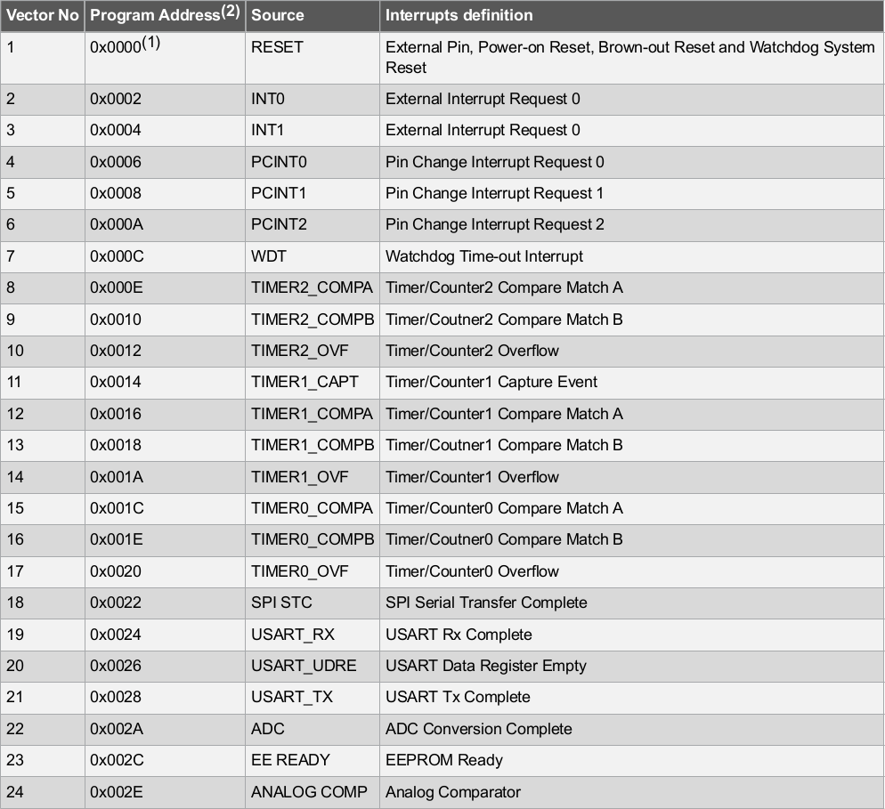
Introduction to Embedded and Robotics Programming
Interrupt vector
The lowest addresses in the program memory space are by default defined as the Reset and Interrupt Vectors.
determined priority levels:
  lower the address -> higher priority level.
RESET has the highest priority
INT0, INT1 – External Interrupt Request 0.
© University of West & Elektrobit (EB) 2018

Slide 5
Introduction to Embedded and Robotics Programming
Interrupt vector
© University of West & Elektrobit (EB) 2018

Slide 6
Introduction to Embedded and Robotics Programming
Interrupts
Two types of interrupts:
1) Triggered by an event
sets the Interrupt Flag.
Program Counter execute Interrupt Vector command
hardware clears the corresponding Interrupt Flag.
Interrupt Flags can also be cleared by software logic
If an interrupt condition occurs while the corresponding interrupt enable bit is cleared, the Interrupt Flag will be set and remembered until the interrupt is enabled
2) Trigger as long as the interrupt condition is present.
do not necessarily have Interrupt Flags.
If the interrupt condition disappears before the interrupt is enabled,
the interrupt will not be triggered.
When the AVR exits from an interrupt, it will always return to the main
program and execute one more instruction before any pending interrupt is served.
© University of West & Elektrobit (EB) 2018
Notes:
A combination of a P-type and N-type semiconductor material (p-n junction)
Forward Bias – current flowing from Anode to Cathode if the + is connected to the anode and the minus to cathode
Reverse bias – conecting minus to anode
Zener diode allow the current to flow in the reverse direction at the Zener voltage
Schottky diode – very fast switching
Tunnel diode – very fast switching in the range of microwave frequency

Slide 7
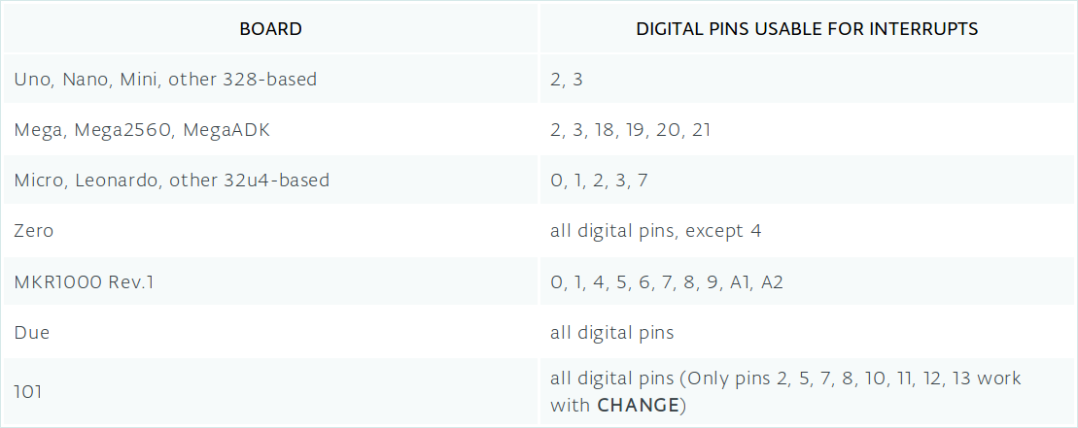
Introduction to Embedded and Robotics Programming
Interrupts – Digital Pins
© University of West & Elektrobit (EB) 2018

Slide 8
Introduction to Embedded and Robotics Programming
Interrupt Service Routines
ISR - special kinds of functions
  cannot have any parameters,
  shouldn’t return anything.
Generally, ISR should be as short and fast as possible.
multiple ISRs, only one can run at a time
millis() relies on interrupts to count, so it will never increment inside an ISR.
delay() requires interrupts, it will not work if called inside an ISR.
Use global variables to pass data between an ISR and the main program.
make sure variables shared between an ISR and the main program are updated correctly, declare them as volatile.
© University of West & Elektrobit (EB) 2018

Slide 9
Introduction to Embedded and Robotics Programming
Interrupt – loops vs ISR
There are a few important things to consider when writing an interrupt service routine
ISRs should be short and sweet. You don't want to derail the main loop for too long!
There are no input variables or returned values. All changes have to be made on global variables.
Few questions: - how do we know when an interrupt gets run? What triggers it? The third function in the `setup()` routine is what sets up the interrupt for the whole system: `attachInterrupt()`
© University of West & Elektrobit (EB) 2018
Notes:
The base acts like the controllable valve, controlling the flow of electrons from the emitter to the collector

Slide 10
Introduction to Embedded and Robotics Programming
Interrupts - attachment
attachInterrupt(digitalPinToInterrupt(pin), ISR, mode); (recommended)
attachInterrupt(interrupt, ISR, mode); (not recommended)
attachInterrupt(pin, ISR, mode); (not recommended Arduino Due, Zero, MKR1000, 101 only)
© University of West & Elektrobit (EB) 2018
Notes:
The base acts like the controllable valve, controlling the flow of electrons from the emitter to the collector

Slide 11
Introduction to Embedded and Robotics Programming
Interrupt – trigger mode
attachInterrupt(digitalPinToInterrupt(pin), ISR, mode);
defines when the interrupt should be triggered
Predefined constants:
  LOW: to trigger the interrupt whenever the pin is low,
  CHANGE: to trigger the interrupt whenever the pin changes value
  RISING: to trigger when the pin goes from low to high,
  FALLING: for when the pin goes from high to low.
  HIGH: to trigger the interrupt whenever the pin is high.(not all arduino)
© University of West & Elektrobit (EB) 2018
Notes:
The base acts like the controllable valve, controlling the flow of electrons from the emitter to the collector

Slide 12
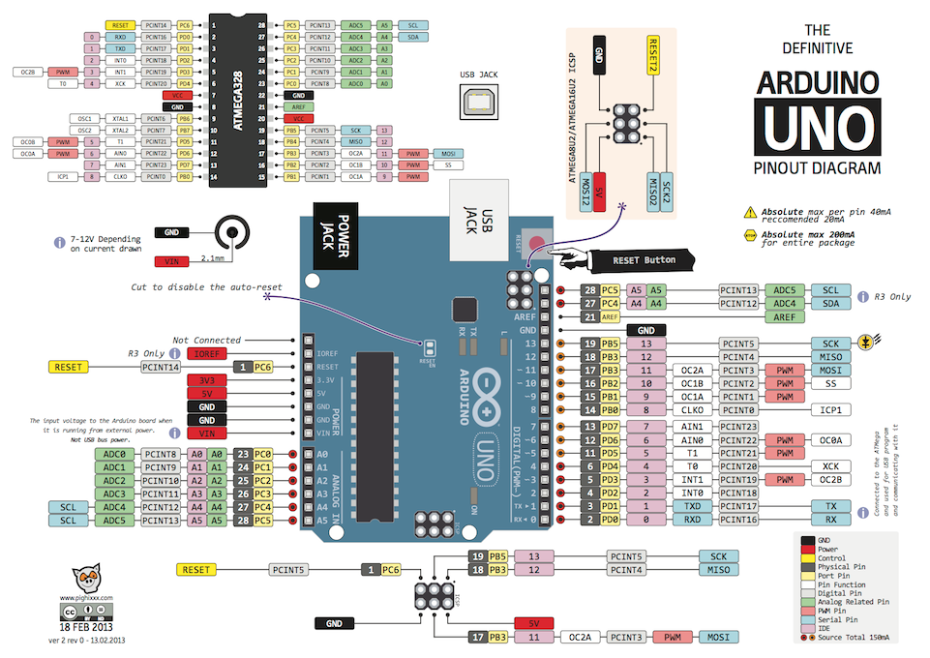
Introduction to Embedded and Robotics Programming
μC Architecture
© University of West & Elektrobit (EB) 2018
Notes:
Dielectric, dielectric polarization
Decoupling – filtering the power for unexpected, short interruption

Slide 13
Introduction to Embedded and Robotics Programming
μC Architecture
More to read:
  http://www.instructables.com/lesson/Capacitors-2/
  https://www.sciencebuddies.org/science-fair-projects/references/how-to-use-a-breadboard
  https://www.kitronik.co.uk/blog/led-resistor-value-calculator/
  https://learn.sparkfun.com/tutorials/diodes
  https://learn.sparkfun.com/tutorials/transistors
© University of West & Elektrobit (EB) 2018

Slide 14
Happy Hacking!
μC U next Week!
μC Architecture
Introduction to
Embedded and Robotics Programming
© University of West & Elektrobit (EB) 2018

